Slide 1
System on Chip Project Presentation
John Westbrook

Slide 2
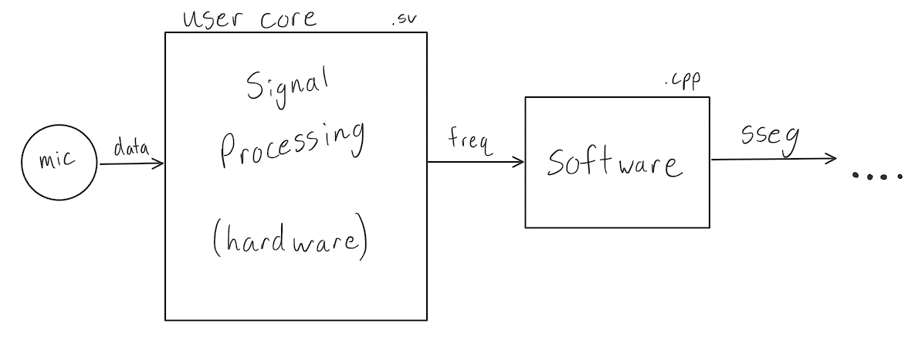
Idea
Capture audio input from on-board microphone
Determine core frequency
Display note of frequency on Seven-Segment Display

Slide 3
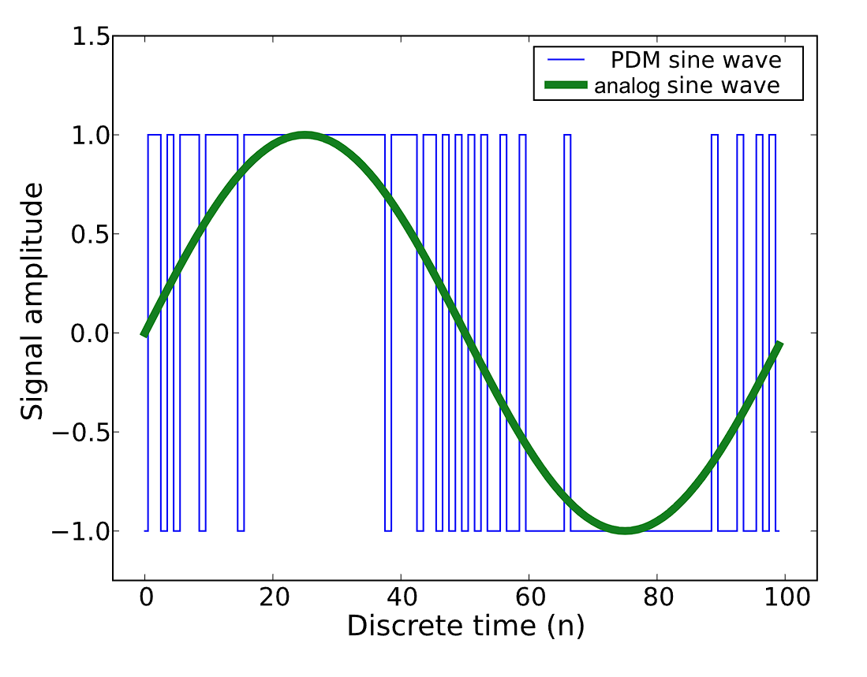
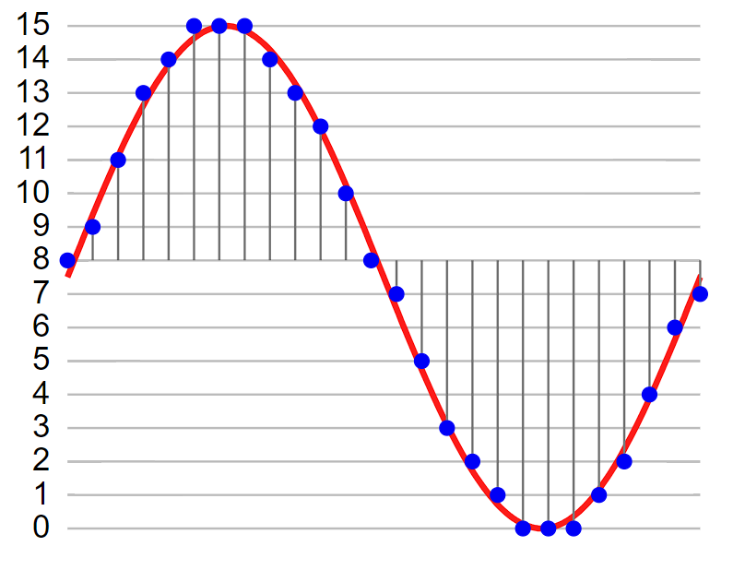
Research
NEXYS4 Microphone outputs Pulse-Density Modulated data
Fast Fourier Transform would be needed to determine frequency
PDM data has a one-bit size, best to convert to different data type
Pulse-Code Modulated Data can better be FFT’ed

Slide 4
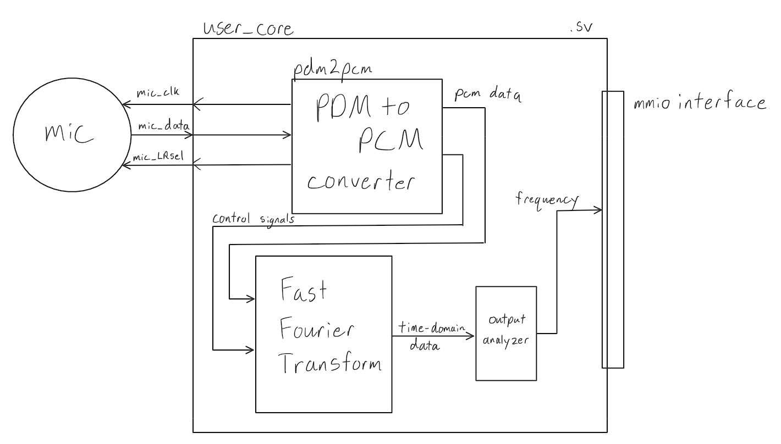
Path to Implementation
Existing Xilinx FFT core
Precedent for PDM to PCM conversion in SystemVerilog
Frequency to note conversion would be done in Vitis
User core would be used

Slide 5
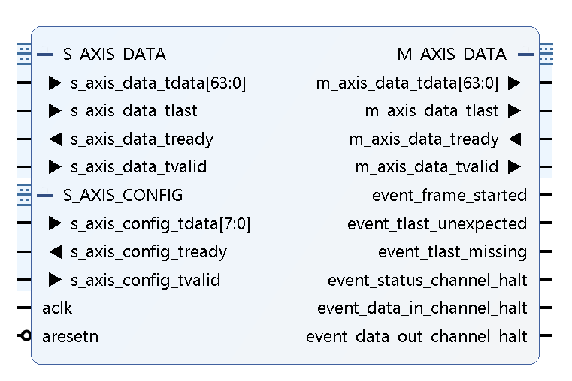
Issues
FFT required complicated timing and control
No examples online for storing and analyzing mic data
Limited understanding of signal processing needed
Noise would be problem

Slide 6
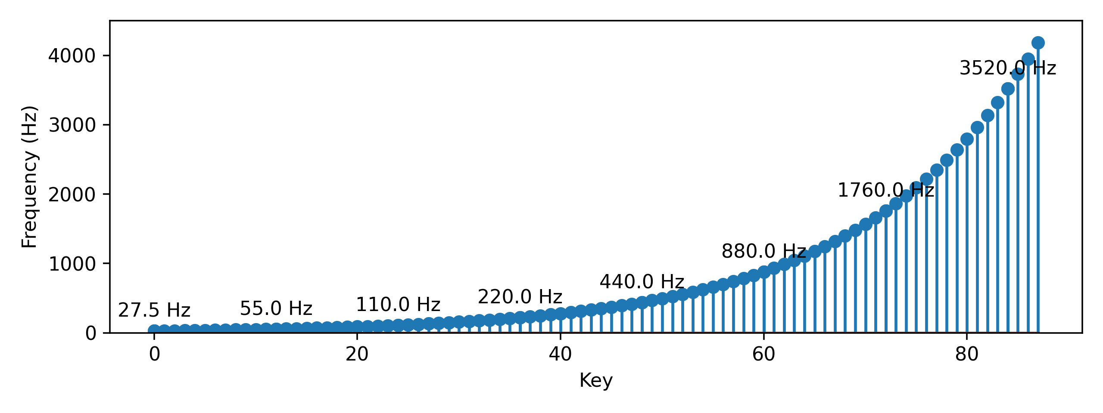

Change in Scope
Use intended frequency to note conversion
Take frequency from keyboard input, display on SSEG
Process
Reverse note frequency equation
Calculate number of semitones from C0 (27.5 Hz)
Determine note based on this distance
$$f_{n}=f_{0}∗{\left(\sqrt[12]{2}\right)}^{n}$$
Octave = numSemitones / 12 (Integer division)
Note = numSemitones % 12

Slide 7
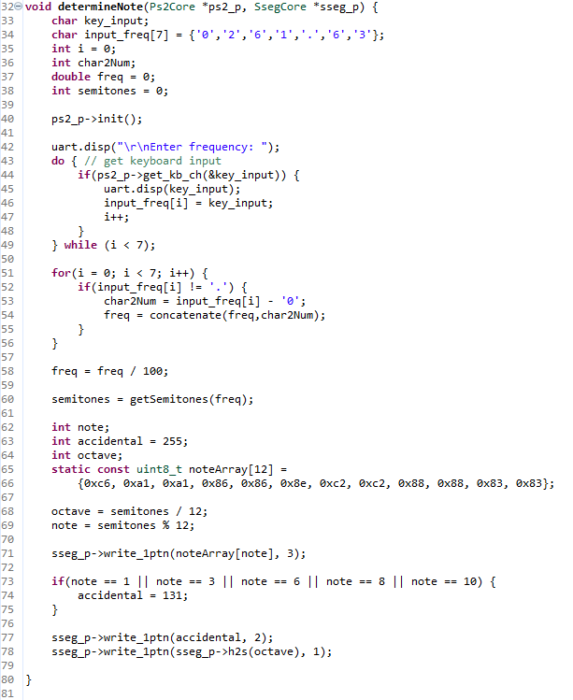
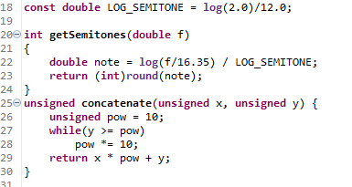
Code

Slide 8
Conclusion
Determine feasibility of project early on
No examples online = red flag
Started project early, but can always start earlier
Digital signal processing is complicated
Take advantage of technical forums

